Slide 1
Salaries Data Engineering
Ana Brissa Miranda espinosa
Sofia garrido
Santiago ayala

Slide 2
Introduction
The primary goal is to provide data that can be a better guidence in regards to what´s being paid globally.
Get the average salary according the job title.
Get 3 countries and review the mínimum and máximum wage and compare them.
Show the average salarie of the top 25 countrys.
Show the % of the ratio through the years (2020-2024).
Show in a map the countries avg salaries and job titles.
Show the size of the company and how many employees have.

Slide 3
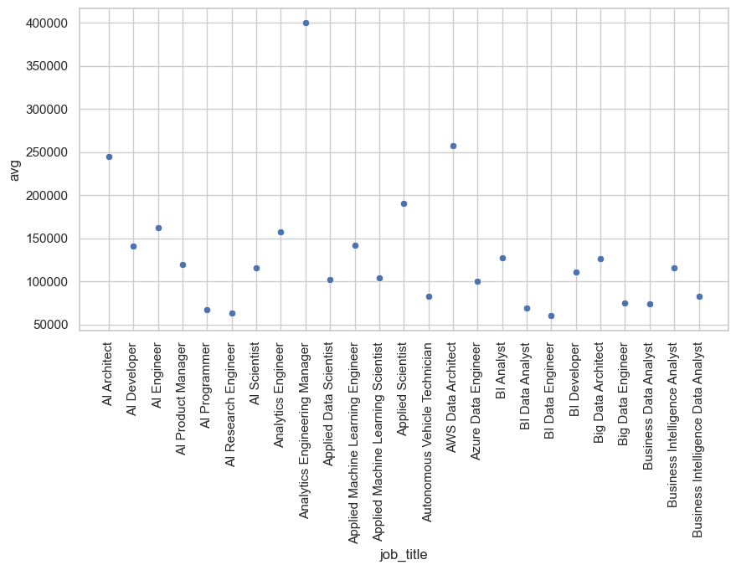
Average Salary for the Job Titles

Slide 4
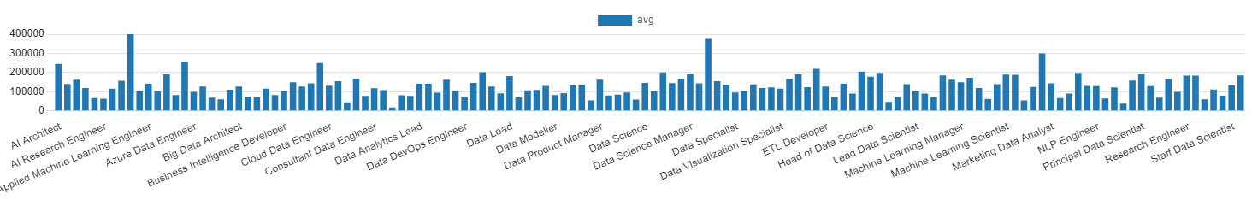
Average Salary for the Job Titles

Slide 5

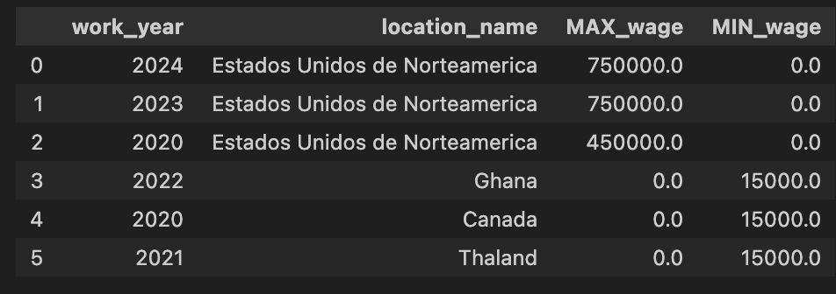



Min vs. Max salary of the top 3 countrys

Slide 6
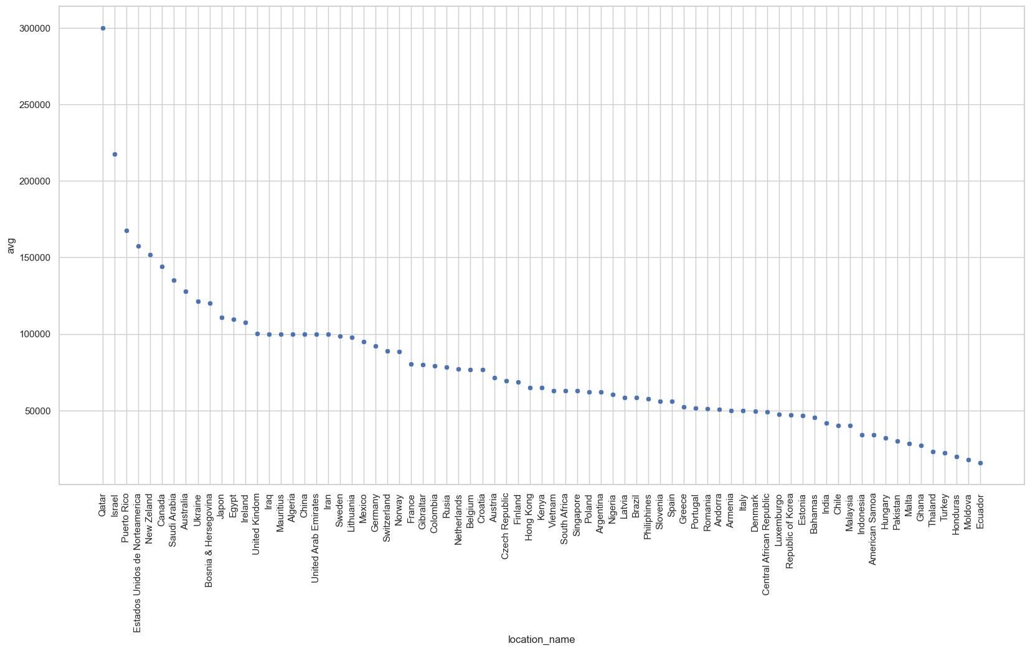
Avg salaries of some countrys

Slide 7
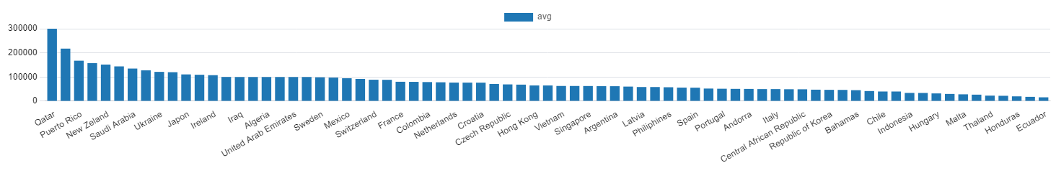
Avg salaries of the countrys

Slide 8
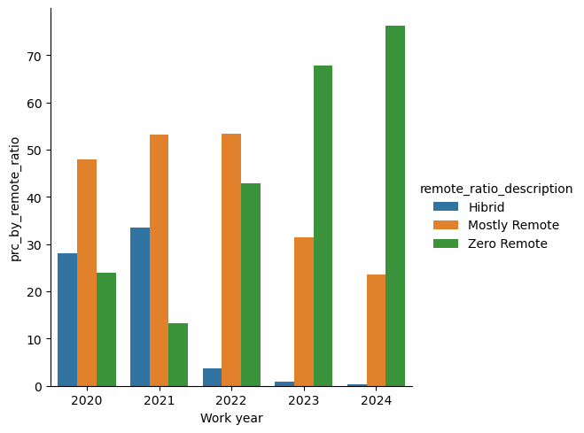
% of the ratio work through the years (2020-2024)

Slide 9
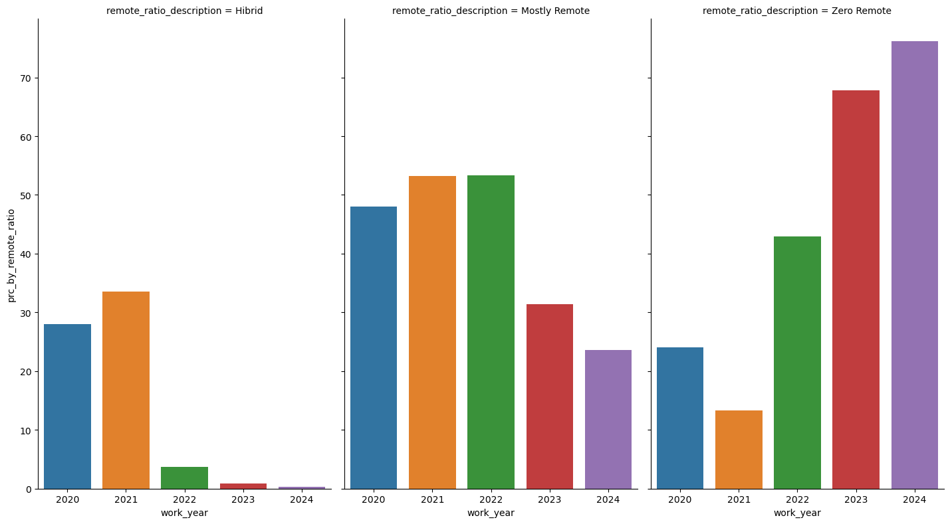
% of the ratio work through the years (2020-2024)

Slide 10

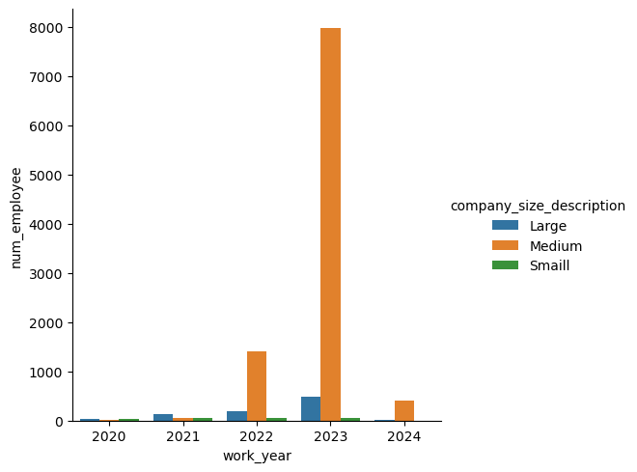
Number of employees by Company Size

Slide 11
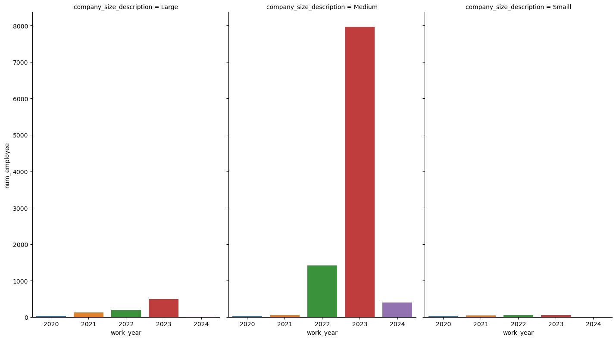
Number of employees by Company Size

Slide 12
Map of the countries

Slide 13
Size of the companies and

